Slide 1
Crop Recommendation And Protection Management
PIP104 PROFESSIONAL PRACTICE-II VIVA-VOCE
Batch Number:CST21
RollNumber:20201CST0182 | Student Name:Pattabhi Ramanjuneyulu
RollNumber:20201CST0180 | Student Name: Abhichandra V
RollNumber:20201CST0177 | Student Name: V Nikhil Koushik
RollNumber:20201CST0164 | Student Name:Chinna Nagi Reddy Bhanu Prakash
RollNumber:20211LCT0001 | Student Name: Yellari Pavan Kumar

Slide 2
PIP104 PROFESSIONAL PRACTICE-II VIVA-VOCE
Under the Supervision of,
Mrs. Ramyavathsala C V
Assistant Professor(G1)
School of Computer Science Engineering & Information Science
Presidency University

Slide 3
Introduction
Modules:
Crop Recommendation: Uses 10 ML and 5 DL models for unbiased crop selection.
Crop Protection: Diagnoses plant diseases using CNN for effective management.
Dataset: Curated dataset from Kaggle for accurate predictions (78.69% - 94.82%).
Approach:
Ensemble of ML and DL models.
Preprocessing of environmental parameters (N, P, K, pH, etc.).
Models: Logistic Regression, SVM, ANN, CNN, LSTM, GRU.
Techniques: Hyperparameter optimization, GridSearchCV.

Slide 4
Introduction
Interface:
User-friendly Streamlit platform.
Crop Recommendation Page: Input environmental parameters for unbiased crop recommendations.
Crop Protection Page: Diagnose plant diseases from images and provide management strategies.
Key Features:
Diverse ML and DL models for robust recommendations.
Detailed disease diagnosis and management strategies.
Impact:
Empowers farmers with data-driven recommendations.
Innovative approach for informed decision-making in agriculture.

Slide 5
Literature Review
The Impact of Artificial Intelligence on Crop Production: A Meta-Analysis
Existing Methods: General assessment of AI's impact on crop yield.
Advantages: Highlights AI's potential to increase crop yield by an average of 10.7%.
Limitations: Lacks detailed analysis of specific AI techniques employed.
A Machine Learning Approach to Crop Recommendation Based on Soil and Climate Data
Existing Methods: Utilizes Random Forest with 95% accuracy in predicting suitable crops.
Advantages: High accuracy in predictions.
Limitations: Lacks specificity in applications and implementation guidelines.

Slide 6
Literature Review
Machine Learning for Crop Recommendation: A Review
Existing Methods: Discusses Decision Trees (88%), Random Forests (90%), SVM (92%).
Advantages: Comprehensive review covering factors and challenges.
Limitations: Lack of focus on specific applications and implementation details.
Smart Farming using Machine Learning and Deep Learning Technique
Existing Methods: Utilizes multiple ML classification algorithms.
Advantages: Identifies the best model for predicting crops using 10 ML models.
Limitations: Focuses solely on ML models.
A Deep Learning Approach to Crop Recommendation
Existing Methods: Employs Convolutional Neural Network (CNN) with 97% accuracy.
Advantages: Develops a DL model with high accuracy.
Limitations: Similar to other studies, lacks specific application focus.

Slide 7
Literature Review
Crop Prediction Using Deep Learning Techniques
Existing Methods: Employs various DL techniques (ANN, CNN, RNN-LSTM, Hybrid networks).
Advantages: Focuses on DL and hybrid techniques.
Limitations: Needs more emphasis on RNN and hybrid networks.
To Compare the Performance of Different Supervised Machine Learning Algorithms for Disease Risk Prediction
Existing Methods: Studies RF, DT, LR, SVM, ANN, GB for disease risk prediction.
Advantages: Focuses on comparing different models.
Limitations: No comparison between least-square and sparse SVMs.

Slide 8
Literature Review
A Comprehensive Comparison of Machine Learning and Deep Learning in Predictive Analytics
Existing Methods: Compares traditional ML with DL.
Advantages: Compares models and discusses their strengths.
Limitations: ML's limited capacity for complex patterns, feature engineering necessary.
Machine Learning vs. Deep Learning: An Empirical Study on Image Classification
Existing Methods: Compares SVM, k-NN, DNN for image classification.
Advantages: Highlights versatility and less training data requirement.
Limitations: Dependency on feature engineering, limited performance on large datasets.
Comparing the Performance of Machine Learning and Deep Learning in Time Series Prediction
Existing Methods: Compares ARIMA, XGBoost, LSTM for time series prediction.
Advantages: Emphasizes model interpretability and faster training times.
Limitations: May not capture complex temporal dependencies, scalability limitations.

Slide 9
Research Gaps Identified
Artificial Intelligence-Based Approaches:
A meta-analysis of AI's impact on crop production lacks detailed insights into specific AI techniques, necessitating comprehensive strategies.
Machine Learning-Based Approaches:
While achieving high accuracies, the models lack focused implementation strategies and application-centric discussions.
Reviews on machine learning models don't provide specific implementation roadmaps despite comprehensive coverage.

Slide 10
Research Gaps Identified
Deep Learning-Based Approaches:
Despite high accuracy (e.g., CNN achieving 97%), deep learning models require specific application focus and implementation strategies.
Further attention is needed on RNN and hybrid models alongside DL models like CNN and ANN.
Comparative Analysis of Techniques:
Comparative analysis lacks depth by focusing solely on ML models, without considering DL models or discussing their comparative advantages.
Supervised learning algorithm comparison lacks analysis between different SVM variants, like least-square and sparse SVMs.
Performance Evaluation of Techniques in Specific Domains:
Exploration of complex temporal dependencies and scalability issues in both ML and DL models is insufficient.
While DL shows promise in NLP, challenges persist in handling semantic nuances and increased computational demands.

Slide 11
Proposed Methodology
Data Acquisition and Preprocessing:
Source data from Kaggle's Crop Production dataset, clean, and select relevant attributes for analysis.
Data Encoding and Standardization:
Encode categorical variables and standardize features for compatibility across models.
Machine Learning Model Training:
Train various ML algorithms, optimize hyperparameters, and split data for training/testing.
Deep Learning Model Training:
Experiment with diverse DL architectures, reshape data accordingly, and perform the train-test split.
Ensemble Model Development:
Integrate top-performing ML and DL models into an ensemble for enhanced prediction accuracy.

Slide 12
Research Gaps Identified
Streamlight Interface Development:
Create user-friendly webpages for Crop Recommendation and Crop Protection using Streamlit.
Design interfaces for capturing environmental parameters and integrate models for real-time predictions.
Crop Recommendation:
Process user inputs through the ensemble model to predict suitable crops and display top recommendations.
Crop Protection:
Utilize a pre-trained CNN model for disease detection based on user-uploaded images.
Predict diseases and provide detailed information, symptoms, and management strategies using a reference file.

Slide 13
Objectives
Enhanced Yield Optimization: Use hybrid ML and DL techniques to suggest optimal crop choices by analyzing soil, climate, and geographical data.
Sustainable Agricultural Practices: Promote eco-friendly farming by recommending diverse crops and resource-efficient cultivation methods.
Crop Protection Management Module:
Early Disease and Pest Detection: Implement deep learning for timely identification of crop diseases and pests, minimizing their impact.
Precision Pest Management: Develop targeted strategies, emphasizing Integrated Pest Management, to minimize chemical use and ensure sustainable pest control.
Data-Driven Decision Support: Empower farmers with data insights for informed decisions in crop protection, optimizing resource usage and overall crop health.

Slide 14
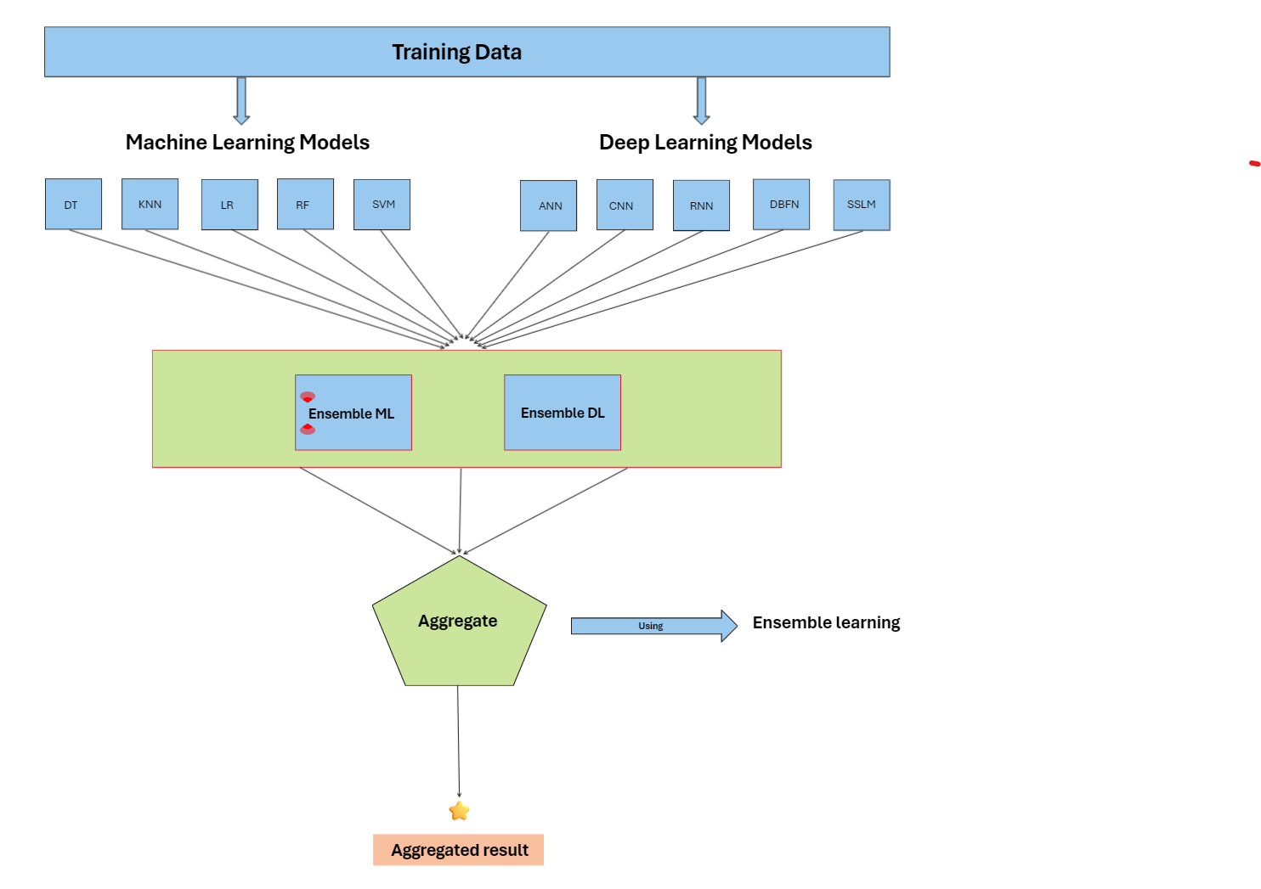
System Design & Implementation
Data Preparation:
Used a Kaggle dataset on crop production, refined it for analysis.
Model Training:
Trained various machine learning and deep learning models for crop recommendation.
Achieved accuracies ranging from 29.08% to 94.82%.
Disease Detection:
Built a system to identify crop diseases using a CNN model.
Achieved a detection accuracy of 78.69%.
Streamlit Interface:
Created a user-friendly interface showcasing crop recommendations and disease identification.
Enabled users to upload images for disease prediction.

Slide 15
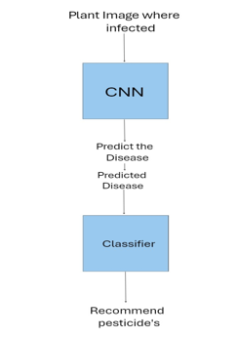
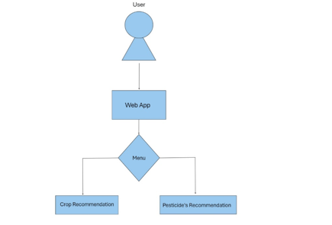
System Design & Implementation

Slide 16
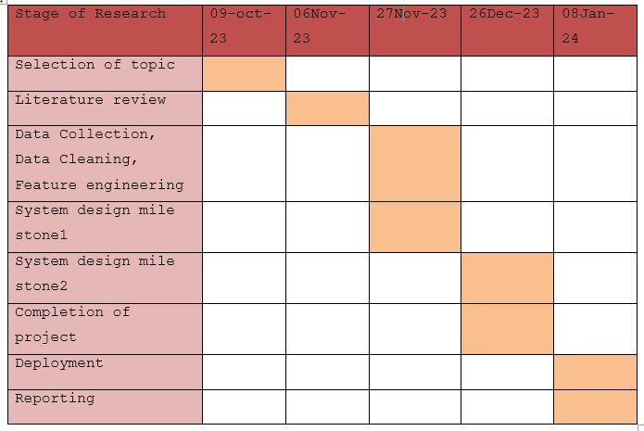
Timeline of Project

Slide 17
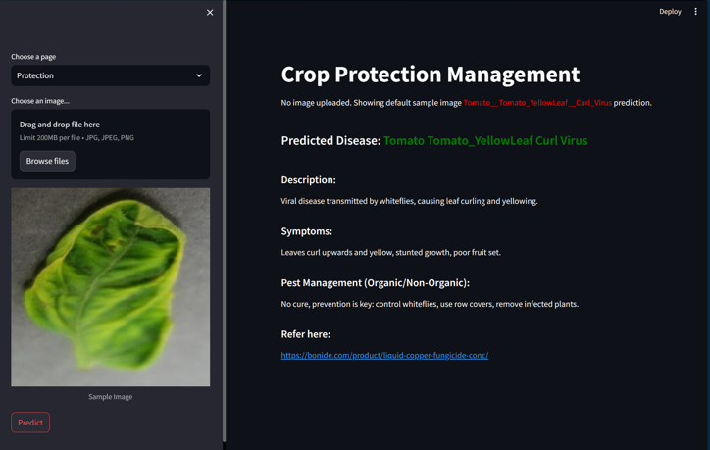
Outcomes / Results Obtained
Outcomes of Agricultural System:
Increased Productivity: Suggested suitable crops, boosting harvest yield through data-backed decisions.
Sustainability Focus: Promoted eco-friendly agriculture and precise disease management strategies.
Analytical Insights:
Informed Decisions: Equipped farmers with data-driven insights for smarter agricultural practices.
Model Evaluation: Comprehensive analysis of ML/DL models for future advancements.
System Utility:
Enhanced User Experience: User-friendly web interface for easy access to recommendations and disease diagnoses.
Integrated Operations: Streamlined integration of ML/DL models for efficient predictions.

Slide 18
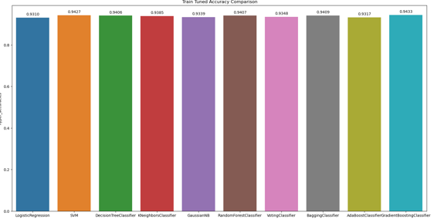
Outcomes / Results Obtained
Technical Achievements:
Model Accuracy: Achieved high accuracy rates in both ML and DL models, exceeding 94%.
Ensemble Model: Created a reliable model combining ML and DL strengths for better results.
Disease Detection: CNN model achieved 78.69% accuracy, aiding early disease identification.
User-Centric Outcomes:
Crop Recommendation: Intuitive interface for personalized crop suggestions based on user inputs.
Crop Protection: User-friendly disease identification system providing detailed management strategies.

Slide 19
Conclusion
Our project is a significant stride in transforming agriculture via technology. We've developed a comprehensive system that recommends crops and detects diseases, empowering informed decision-making for enhanced productivity and sustainability.
Our blend of machine and deep learning models ensures unbiased, robust predictions that prioritize sustainable farming practices. The disease detection module, powered by a CNN model, promotes proactive measures, potentially reducing reliance on harmful chemicals.
The user-friendly web platform offers personalized insights, enabling quick decisions based on valuable data. Looking ahead, we aim to incorporate real-time data and advanced models for wider accessibility and improved adaptability.
Our commitment is to bridge data science and farming for a sustainable future, enabling smarter, data-driven decisions in agriculture for generations to come."

Slide 20
References
Steinmetz et al. (2020) conducted a meta-analysis on AI's impact on crop production, emphasizing its significance in agricultural advancements. Journal of Agricultural Science.
Patel et al. (2020) proposed a machine learning-based crop recommendation system leveraging soil and climate data. International Journal of Agricultural and Biological Engineering.
Patel, D., et al. (2021) reviewed various machine learning techniques for crop recommendation. International Journal of Engineering Research & Technology.
Uddin (2019) compared supervised machine learning algorithms for disease risk prediction. BMC Medical Informatics and Decision Making.
Shamili (2022) explored smart farming utilizing machine learning and deep learning techniques. Computers and Electronics in Agriculture.
Sharma et al. (2019) employed a deep learning approach for crop recommendation. Journal of Agriculture Science and Technology.
Dharani (2021) focused on crop prediction using deep learning techniques. Frontiers in Plant Science.

Slide 21
References
Smith & Chen (2019) provided a comprehensive comparison of machine learning and deep learning in predictive analytics. Expert Systems with Applications.
Wang & Patel (2017) conducted an empirical study comparing machine learning and deep learning for image classification. arXiv preprint.
Liu & Rodriguez (2020) compared machine learning and deep learning performance in time series prediction. Journal of Computational Science.
Gupta & Kim (2018) evaluated trade-offs between machine learning and deep learning in natural language processing. arXiv preprint.
Zhang et al. (2020) proposed ensemble learning for crop recommendation in precision agriculture. arXiv preprint.
Hasan (2023) developed an ensemble machine learning-based recommendation system for effective crop cultivation prediction. Frontiers in Plant Science.

Slide 22
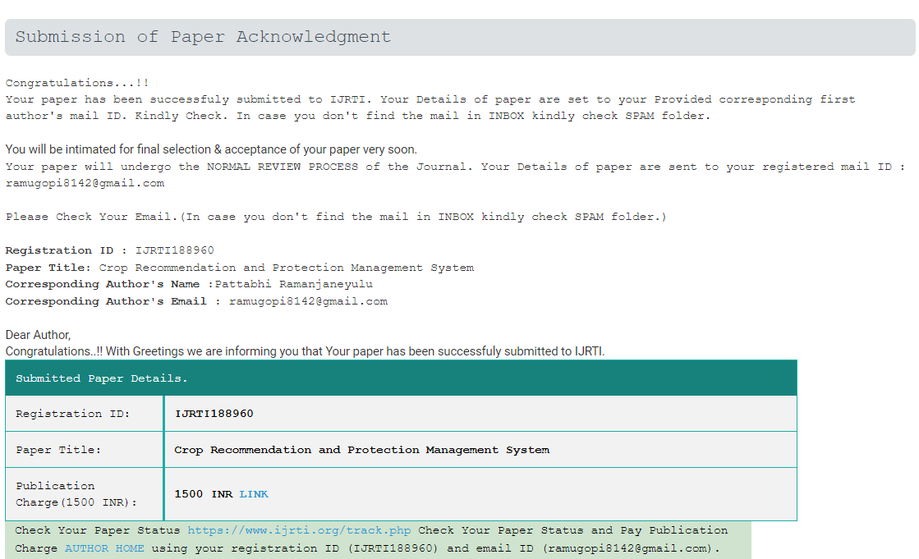
Publication Details

Slide 23

Thank You

